Slide 1
Data Protection: Data mining and data release
Beyond the book

Slide 2
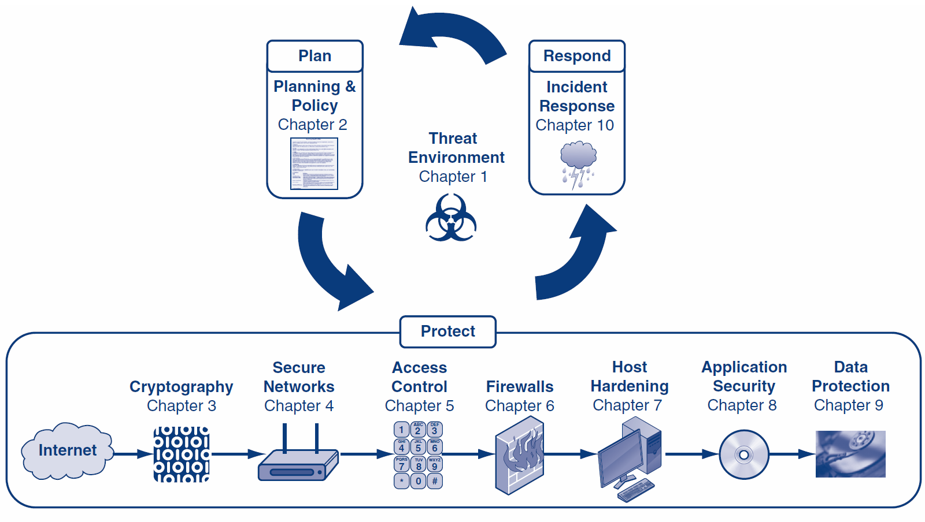

Slide 3

Using views
The data base can respond to a query based on a view that is created for the current user.
DB
View

Slide 4
Using views
Truman semantics:
Pretending that there is nothing to hide
Non-Truman semantics:
Some results cannot be returned

Slide 5
AOL search data leak
https://en.wikipedia.org/wiki/AOL_search_data_leak
https://www.michaelzimmer.org/2006/08/09/aol-search-log-profiles-unmasked/

Slide 6
Data disclosure
Disclosing the exact data
Disclosing the bounds of the data
Disclosing existence
Disclosing probability

Slide 7
Disclosing the exact data
Data is provided without any modification or protection

Slide 8
Disclosing the bounds of the data
Data is given between bounds or above or below a threshold:
Age between 20 to 25
Age > 20
Age < 20

Slide 9
Disclosing existence
Positive results: There exist someone in a household with a genetic condition
Negative results: Not having a clear record

Slide 10
Disclosing probability
Person X being a member of a group with a certain probability.

Slide 11
Answering queries instead
Complex queries can bypass the checks
Example:
SELECT SUM(grades) FROM students
WHERE firstname = ‘Alice’
OR (studentID > 20 and studentID < 1)

Slide 12
Answering queries instead
Tracker attacks:
Suppose an attacker wants to query about a subset C. If R(X) is the response to the query about subset X of the data and S is the entire data, the attacker will send queries for S, C or T, and C or not T, where T is a tracker.
R(C) = R(C or T) + R(C or not T) – R(S)

Slide 13
Reducing granularity of data
k-anonymity
l-diversity
t-closeness

Slide 14
k-anonymity
ZIP | DOB | Disease
50232 | 1965-07-11 | Covid19
50211 | 1965-08-01 | Covid19
50233 | 1965-07-12 | Covid19
50255 | 1950-12-12 | Cancer
50512 | 1954-01-01 | Covid19
31403 | 2020-08-01 | No Teeth
31402 | 2001-01-01 | Covid19
31401 | 2012-01-01 | Flu
ZIP | DOB | Disease
50* | 19*-*-* | Covid19
50* | 19*-*-* | Covid19
50* | 19*-*-* | Covid19
50* | 19*-*-* | Cancer
50* | 19*-*-* | Covid19
3140* | 20*-*-* | No Teeth
3140* | 20*-*-* | Covid19
3140* | 20*-*-* | Flu

Slide 15
l-diversity
ZIP | DOB | Disease
502* | 196*-*-* | Covid19
502* | 196*-*-* | Covid19
502* | 196*-*-* | Covid19
50* | 195*-*-* | Covid19
50* | 195*-*-* | Cancer
50* | 195*-*-* | Covid19
3140* | 20*-*-* | No Teeth
3140* | 20*-*-* | Covid19
3140* | 20*-*-* | Flu

Slide 16
Differential Privacy
A hot topic of research
The goal is to publicly share information, without anyone being able to determine if a certain record exists in the database.

Slide 17
The End

Slide 18
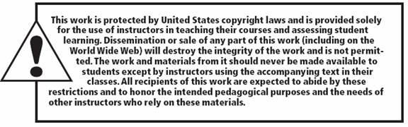
All rights reserved. No part of this publication may be reproduced, stored in a retrieval system, or transmitted, in any form or by any means, electronic, mechanical, photocopying, recording, or otherwise, without the prior written permission of the publisher. Printed in the United States of America.
Copyright © 2015 Pearson Education, Inc.

